Slide 1





Slide 2

Learning Objectives:
🌱 Understand the importance of garbage classification in real-world waste management. 🚀 Apply Transfer Learning using pre-trained CNN models (like MobileNetV2 or ResNet50) to classify waste images into 6 categories – cardboard, glass, metal, paper, plastic, and trash. 🔄 Learn how to preprocess image data for computer vision tasks using TensorFlow and Keras. 🧠 Explore the benefits of using Transfer Learning to reduce training time and increase accuracy with limited data. 📊 Evaluate model performance using metrics like accuracy, loss, and confusion matrix. 🎯 Deploy the trained model in a user-friendly web interface using Gradio.
GOAL: To develop an accurate and efficient garbage classification model using EfficientNetV2B2 and transfer learning for automated waste sorting.
GOAL
Source :
www.freepik.com/

Slide 3

Tools and Technology used
This project leverages a suite of modern tools and frameworks:
Programming Language: Python
Deep Learning Frameworks: TensorFlow, Keras
Model Architecture: EfficientNetV2B2 (Pretrained on ImageNet)
Development Environment: Google Colab / Jupyter Notebook
Libraries: NumPy, Pandas, Matplotlib, scikit-learn
Hardware Acceleration: GPU-enabled runtime
Dataset: Garbage classification dataset with six classes

Slide 4

Data Acquisition: Curated dataset containing labeled images across six categories:
Cardboard, Plastic, Paper, Trash, Glass, and Metal.
Data Preprocessing:
Resizing, normalization, and augmentation to enhance model generalization.
Model Development:
Employed EfficientNetV2B2 with transfer learning to utilize pre-trained feature extractors.
Training Strategy:
Fine-tuning with class weighting to mitigate class imbalance.
Evaluation & Visualization:
Monitored accuracy, loss, and confusion matrix for performance validation.
Methodology

Slide 5
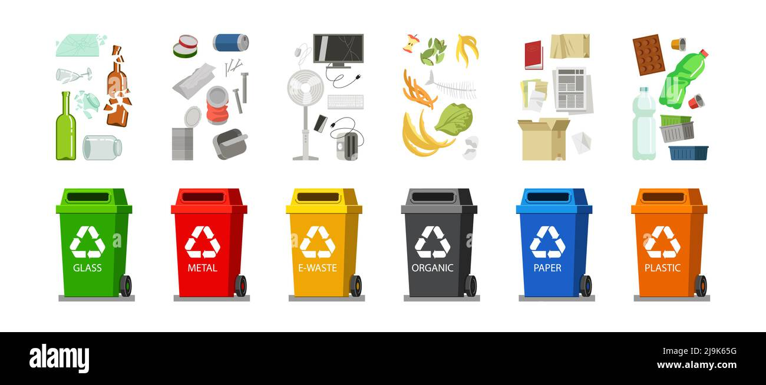

Slide 6

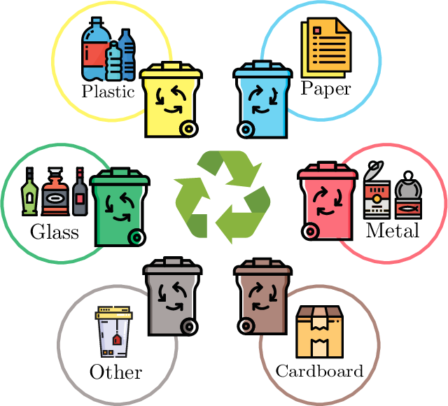
Cardboard
Corrugated boxes, brown paperboard, packing material
Plastic
Bottles, containers, wrappers, synthetic packaging
Paper
Newspapers, office paper, magazines, notebooks
Trash
Non-recyclable waste, dirty items, food-soiled materials
Glass
Bottles, jars, broken glass, transparent containers
Metal
Aluminum cans, tin containers, metal scraps, foil

Slide 7

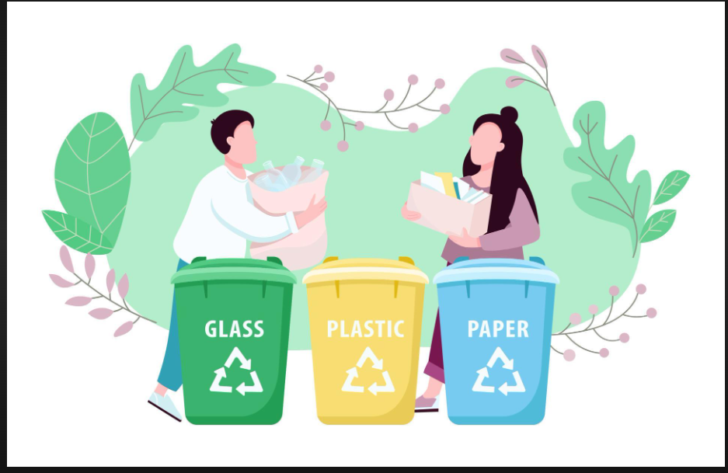
Problem Statement:
In this project, we aim to develop a sophisticated **garbage classification system** leveraging the **EfficientNetV2B2** architecture. Our primary dataset serves as a foundation for building models that can eventually automate waste segregation, a critical step in optimizing recycling and waste management, ultimately aiding in environmental conservation.
In the era of environmental challenges, efficient waste management has become crucial. Manual segregation is time-consuming and prone to error.
This project aims to build an intelligent garbage classification system using EfficientNetV2B2, a high-performance convolutional neural network, to automate waste sorting processes.

Slide 8
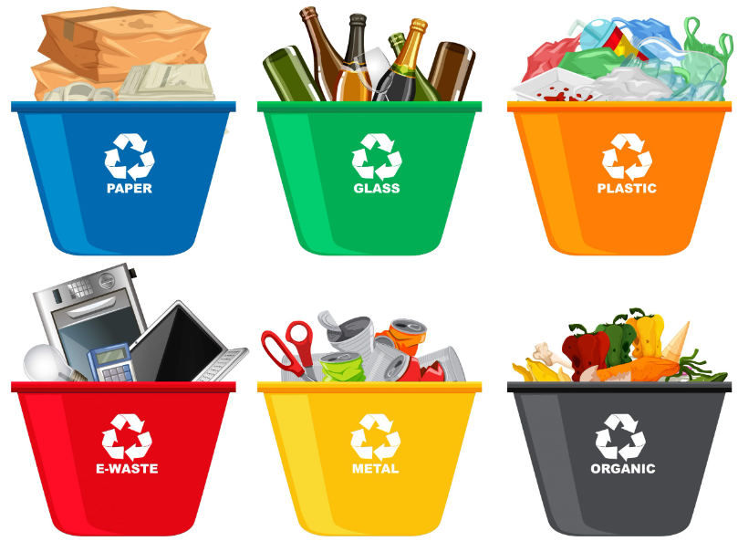
✅ Goal
To design and implement a robust image classification model that:
Accurately distinguishes between different types of waste.
Leverages transfer learning for improved accuracy and reduced training time.
Can serve as a foundational component in smart recycling and automated waste segregation systems.
✅ Challenges & Scope
Class Imbalance: Uneven distribution of sample images across categories.
Visual Similarity: Some classes (e.g., cardboard vs. paper) have overlapping features.
Real-world Applicability: Ensuring the model generalizes well to new data.
Scalability: Potential integration into smart bins or mobile apps.

Slide 9
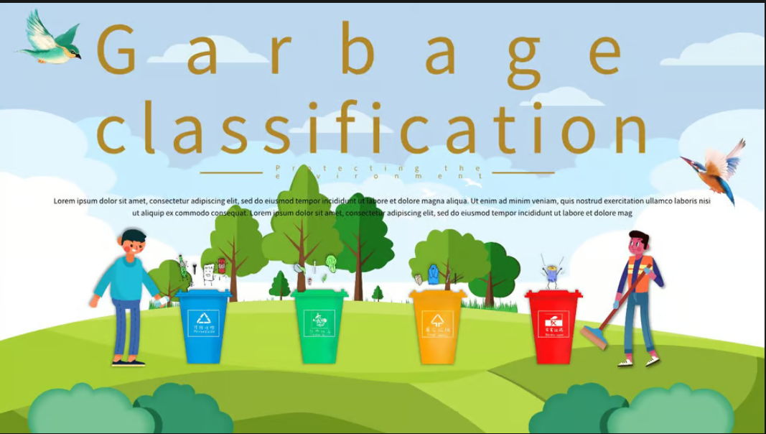
Solution:
Our solution integrates deep learning and transfer learning to address the problem effectively:
Utilized EfficientNetV2B2, pretrained on ImageNet, as the base model.
Added custom classification layers suited for our dataset.
Employed data augmentation to synthetically balance the dataset.
Implemented class weighting during training to mitigate skewed class representation.
Achieved high model performance with minimal computational cost and training time.

Slide 10
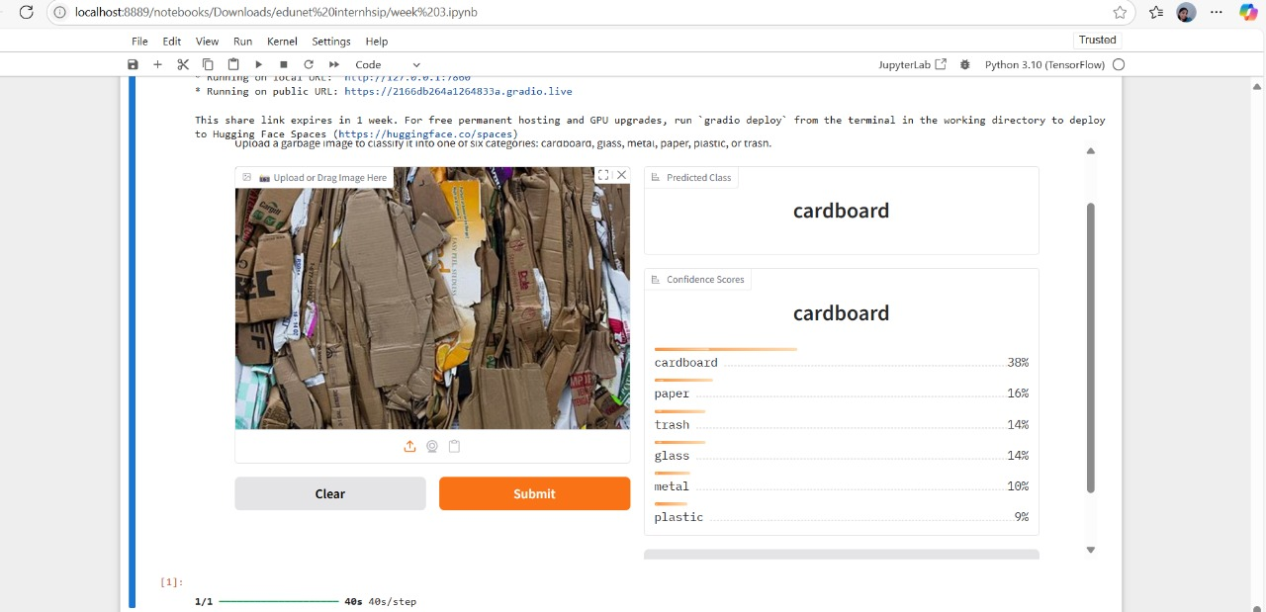
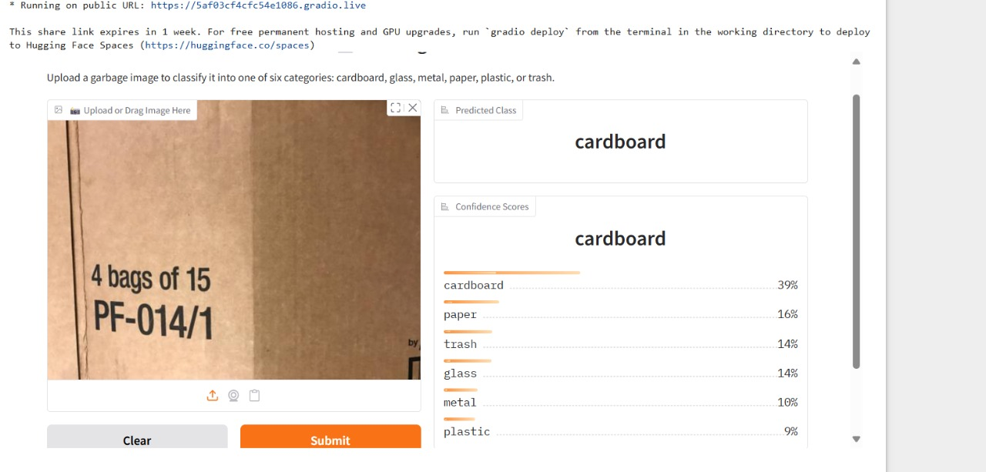
Screenshot of Output:

Slide 11
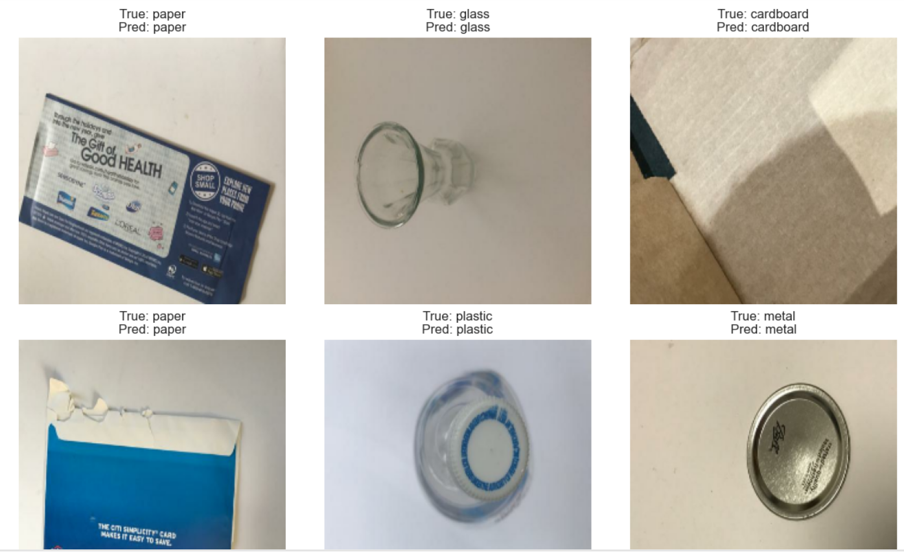

Slide 12
Conclusion:
This project demonstrates the successful implementation of an AI-powered garbage classification system using state-of-the-art deep learning techniques.
Key takeaways:
Transfer learning significantly accelerates development and improves accuracy.
EfficientNetV2B2 offers a balance of speed and precision for classification tasks.
Such models can be deployed in real-world applications for automated recycling, contributing to environmental sustainability and smart city development.

Slide 13
